Slide 1
Ch 18 (edition 3 book) learning
Dr. Malak Abdullah
Computer Science Department
Jordan University of Science and Technology

Slide 2
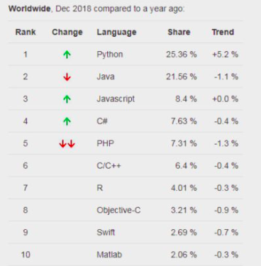
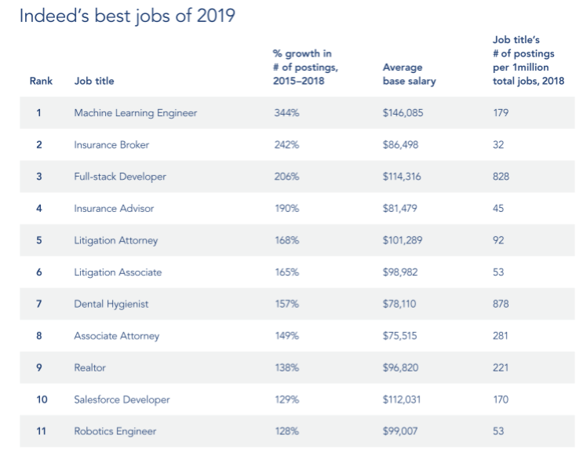

Slide 3
What is Learning?
“Learning denotes changes in a system that ... enable a system to do the same task … more efficiently the next time.” - Herbert Simon
“Learning is constructing or modifying representations of what is being experienced.” - Ryszard Michalski
“Learning is making useful changes in our minds.” - Marvin Minsky
Learning: a process for improving the performance of an agent through experience

Slide 4
Learning: Why?
Instead of trying to produce a programme to simulate the adult mind, why not rather try to produce one which simulates the child's? If this were then subjected to an appropriate course of education one would obtain the adult brain. Presumably the child brain is something like a notebook as one buys it from the stationer's. Rather little mechanism, and lots of blank sheets.
[Alan Turing, 1950]
Learning is useful as a system construction method, i.e., expose the system to reality rather than trying to write it down

Slide 5
Key questions when building a learning agent
What is the agent design that will implement the desired performance?
Improve the performance of what piece of the agent system and how is that piece represented?
What data are available relevant to that piece? (In particular, do we know the right answers?)
What knowledge is already available?

Slide 6
What is Machine learning
Machine learning technology teaches computers how to perform tasks by learning from data instead of being explicitly programmed.
The process of teaching a computer system how to make accurate predictions when fed data.
Those predictions could be
answering whether a piece of fruit in a photo is a banana or an apple
spotting people crossing the road in front of a self-driving car
whether the use of the word book in a sentence relates to a paperback or a hotel reservation
whether an email is spam
recognizing speech accurately enough to generate captions for a YouTube video.
The key difference from traditional computer software is that a human developer hasn't written code that instructs the system how to tell the difference between the banana and the apple.

Slide 7
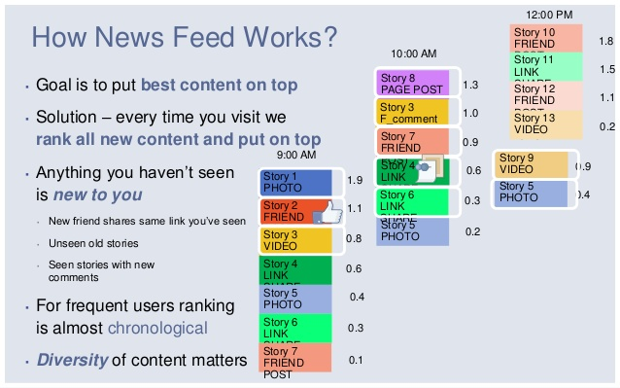
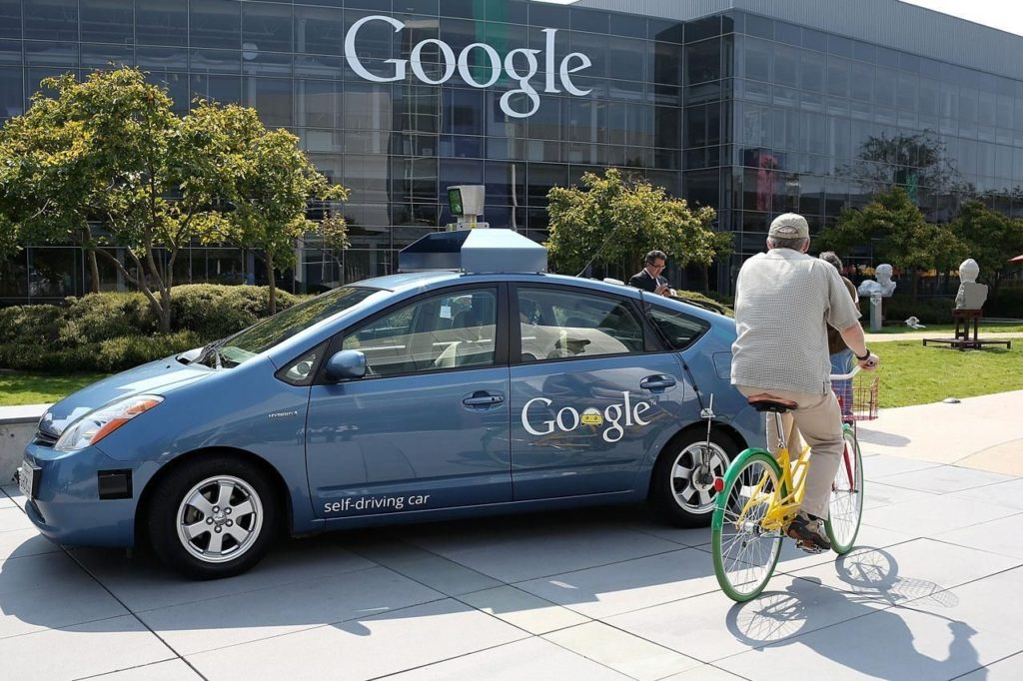
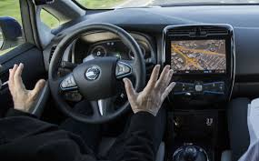

Facebook
The News Feed uses machine learning to personalize each member's feed.
If a member frequently stops scrolling to read a particular friend's posts, the News Feed will start to show more of that friend's activity earlier in the feed.
Google

Slide 8

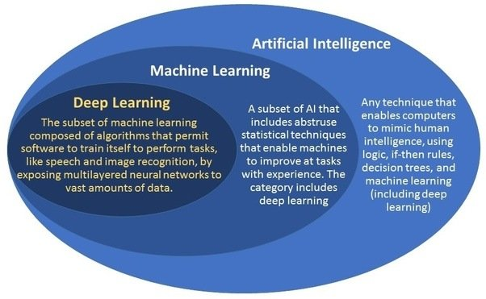

WHAT IS THE DIFFERENCE BETWEEN AI AND ML?
ML is just one method for achieving artificial intelligence.
While artificial intelligence (AI) is the broad science of mimicking human abilities, machine learning is a specific subset of AI that trains a machine how to learn.

Slide 9
Machine learning algorithms are often categorized as :
Supervised machine learning algorithms can apply what has been learned in the past to new data using labeled examples to predict future events.
unsupervised machine learning algorithms are used when the information used to train is neither classified nor labeled. Unsupervised learning studies how systems can infer a function to describe a hidden structure from unlabeled data
Semi-supervised machine learning algorithms fall somewhere in between supervised and unsupervised learning, since they use both labeled and unlabeled data for training – typically a small amount of labeled data and a large amount of unlabeled data. The systems that use this method are able to considerably improve learning accuracy.
Reinforcement machine learning algorithms is a learning method that interacts with its environment by producing actions and discovers errors or rewards. Trial and error search and delayed reward are the most relevant characteristics of reinforcement learning.
For example, the lack of a tip at the end of the journey gives the taxi agent an indication that it did something wrong. The two points for a win at the end of a chess game tells the agent it did something right. It is up to the agent to decide which of the actions prior to the reinforcement were most responsible for it.

Slide 10
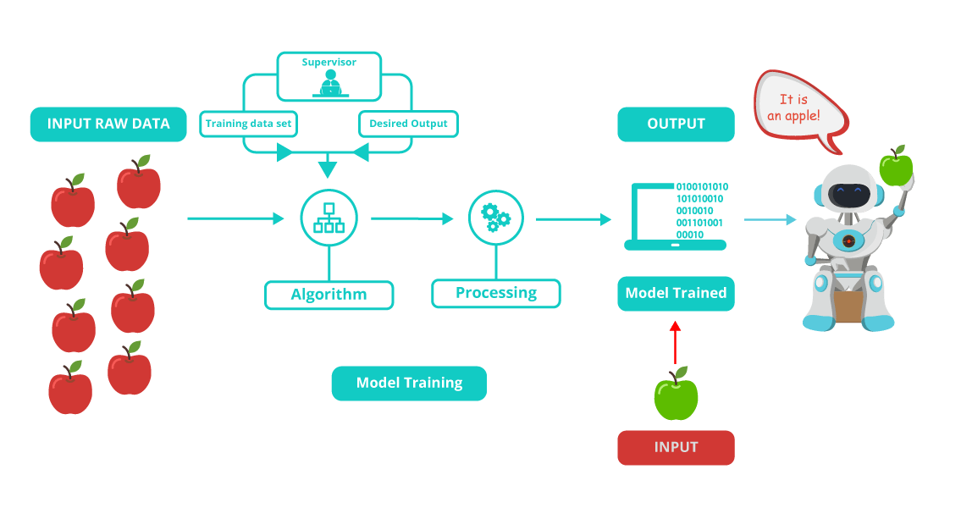
Supervised algorithm is mainly divided into:
Training Phase
Testing phase

Slide 11
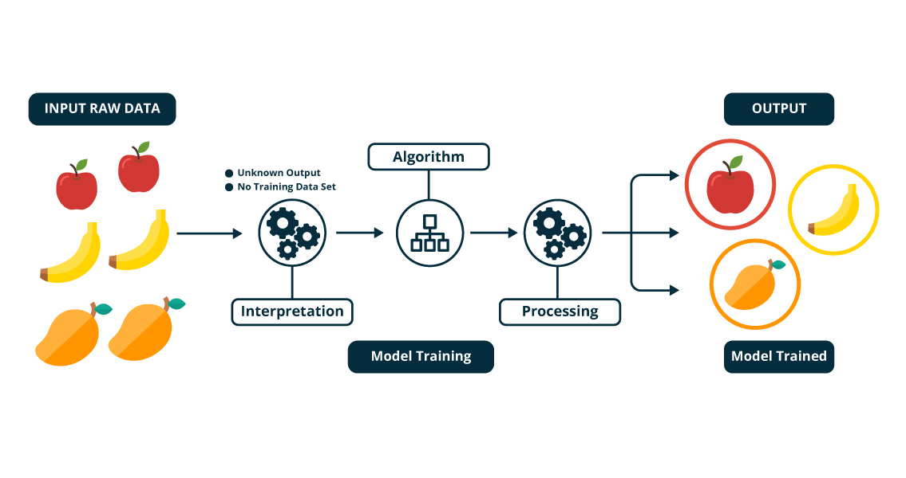
Unsupervised Learning?
Mathematically, Unsupervised learning is where you only have input data (X) and no corresponding output variables.
The goal for unsupervised learning is to model the underlying structure or distribution in the data in order to learn more about the data.

Slide 12
In this Course, We will discuss Supervised Learning

Slide 13
Supervised learning
To learn an unknown target function f
Input: a training set of labeled examples (x_{j},y_{j}) where y_{j} = f(x_{j})
E.g., x_{j} is an image, f(x_{j}) is the label “giraffe”
Output: hypothesis h that is “close” to f, i.e., predicts well on unseen examples (“test set”)
Many possible hypothesis families for h
Linear models, logistic regression, neural networks, decision trees, etc etc
Classification = learning f with discrete output value
Regression = learning f with real-valued output value

Slide 14
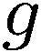
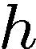

Inductive Learning (Science)
Simplest form: learn a function from examples
A target function: g
Examples: input-output pairs (x, g(x))
E.g. x is an email and g(x) is spam / ham
E.g. x is a house and g(x) is its selling price
Problem:
Given a hypothesis space H
Given a training set of examples x_{i}
Find a hypothesis h(x) such that h ~ g
Includes:
Classification (outputs = class labels)
Regression (outputs = real numbers)

Slide 15
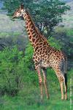
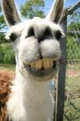
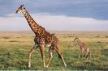
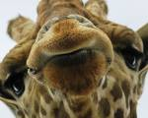
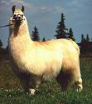
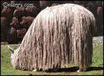
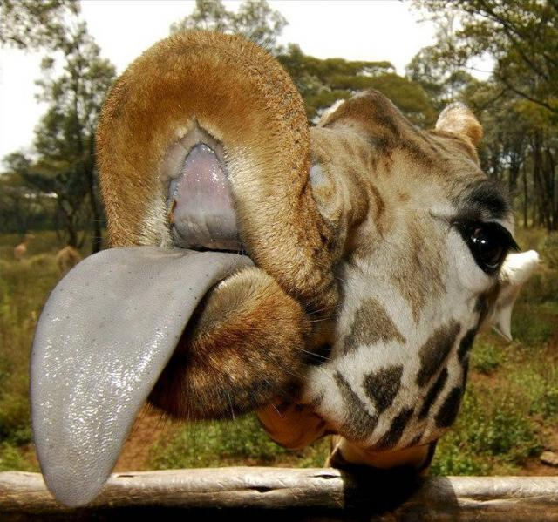
Classification example: Object recognition
x
f(x)
giraffe
giraffe
giraffe
llama
llama
llama
X=
f(x)=?

Slide 16
The machine learning framework
y = f(x)
output
prediction function
Image feature
Training: given a training set of labeled examples {(x₁,y₁), …, (x_{N},y_{N})}, estimate the prediction function f by minimizing the prediction error on the training set
Testing: apply f to a never before seen test example x and output the predicted value y = f(x)
Slide credit: L. Lazebnik

Slide 17

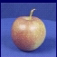
Training
Training Labels
Training Images
Image Features
Training
Learned model
Testing
Image Features
Learned model
Prediction
Test Image

Slide 18
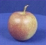
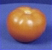
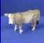
The machine learning framework
Apply a prediction function to a feature representation of the image to get the desired output:
f( ) = “apple”
f( ) = “tomato”
f( ) = “cow”

Slide 19
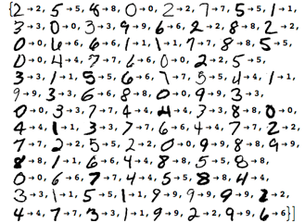
Recognizing your handwriting
Training the ML model by giving it examples of 10,000 or more handwritten digits, as well as the correct answer.
After the model is trained, we can test how well the model performs by giving it 1,000 new handwritten digits without the correct answer. The model is then required to recognize the actual digit.

Slide 20
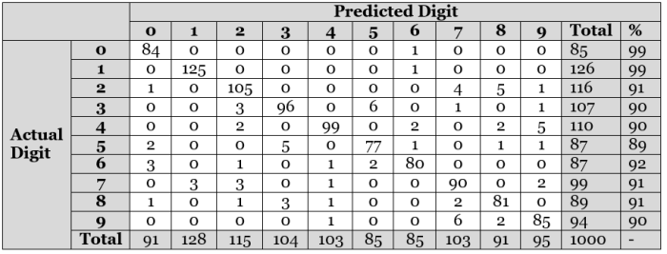
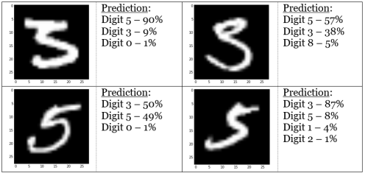

Slide 21
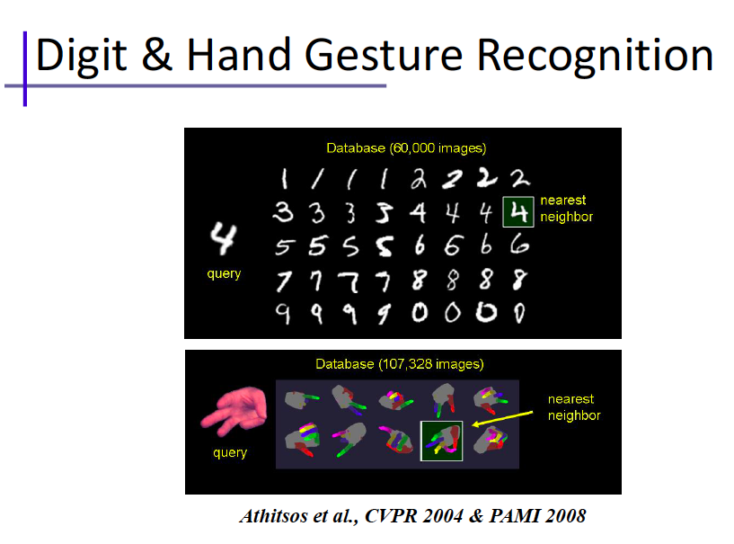

Slide 22

ML Workflow

Slide 23
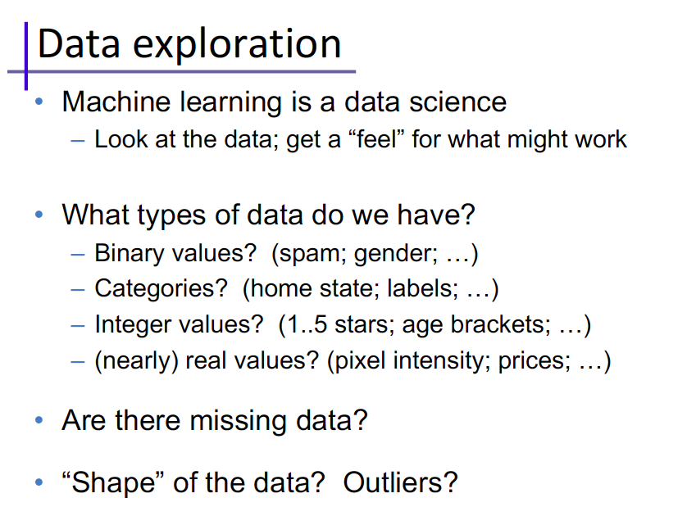
Convert Data to numbers

Slide 24
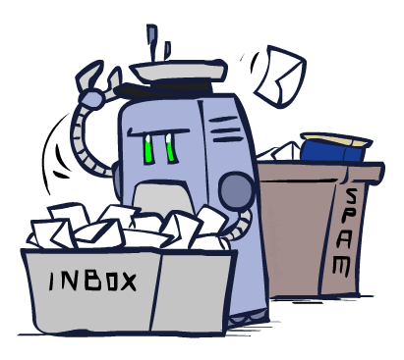
Classification

Slide 25
Classification definition
Given a collection of samples (training set)
Each sample contains a set of attributes.
Each sample also has a discrete class label
Learn a model that predicts class label as a function of the values of the attributes.
Goal: model should assign class labels to previously unseen samples as accurately as possible.
A test set is used to determine the accuracy of the model. Usually, the given data set is divided into training and test sets, with training set used to build the model and test set used to validate it.

Slide 26

Many classifiers to choose from
Which is the best one?
SVM
Neural networks
Naïve Bayes
Bayesian network
Decision Tree
K-nearest neighbor
Etc.

Slide 27
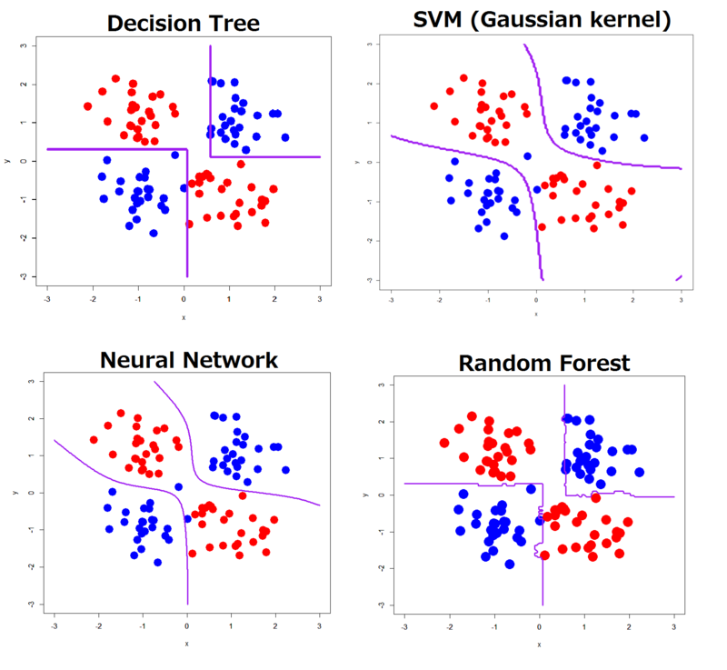
Classifiers!!

Slide 28
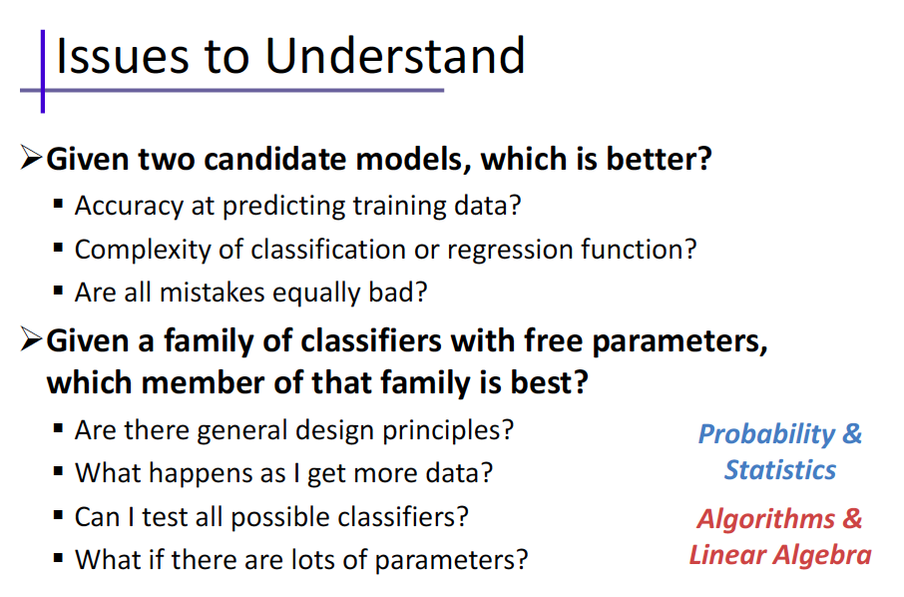

Slide 29

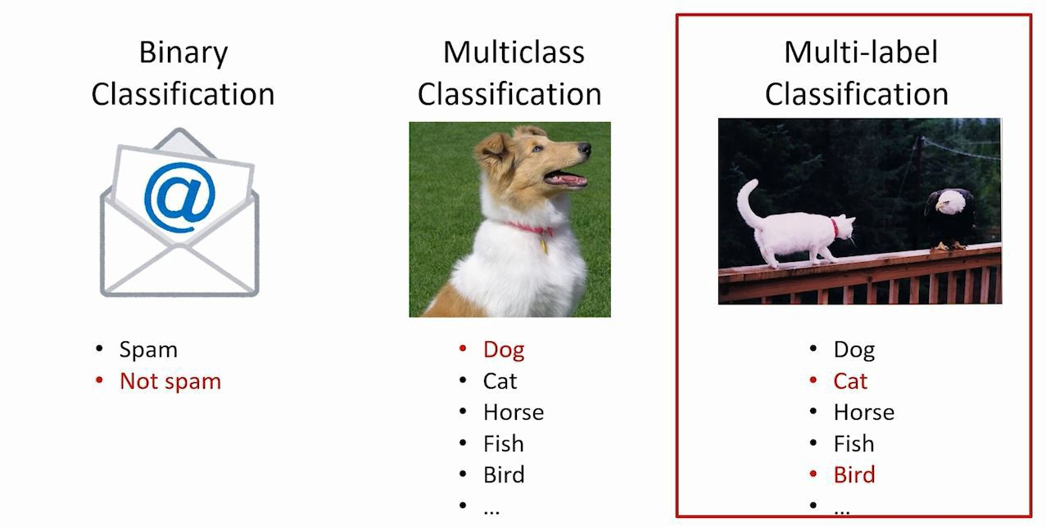
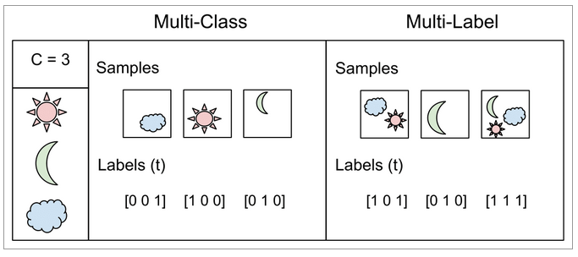
Examples of classification tasks
Two classes
Predicting tumor cells as benign or malignant
Classifying credit card transactions as legitimate or fraudulent
Multiple classes
Categorizing news stories as finance, weather, entertainment, sports, etc
Multilabel classification
Consider a face-recognition classifier: recognizes several people on the same picture
Say the classifier has been trained to recognize three faces, Alice, Bob, and Charlie; then when it is shown a picture of Alice and Charlie, it should output [1, 0, 1]
Such a classification system that outputs multiple binary labels is called a multilabel classification system.
Notes:
Examples 3 & 4 are multiclass classification problems.

Slide 30
Stages in a classification task
Notes:
In context of machine learning, the term “induce” is roughly equivalent to “learn” or “train”.

Slide 31
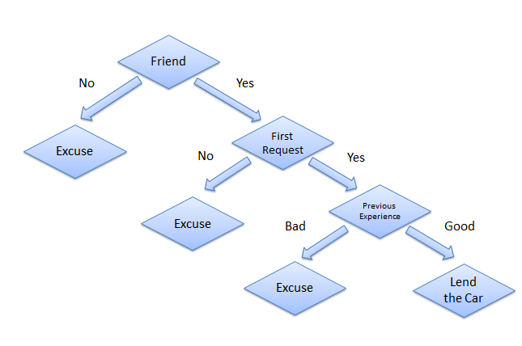
Example from the life
Consider a scenario where a person asks you to lend them your car for a day, and you have to make a decision whether or not to lend them the car. There are several factors that help determine your decision, some of which have been listed below:
Is this person a close friend or you just slightly know him? If he is not a close friend, then decline the request; if the person is a friend, then move to next step.
Is the person asking for the car for the first time? If so, lend them the car, otherwise move to next step.
Was the car damaged last time they returned the car? If yes, decline the request; if no, lend them the car.

Slide 32
Decision tree classification task
Decision Tree

Slide 33
Example of a decision tree
nominal
nominal
ratio
class
splitting nodes
Refund
Yes
No
NO
MarSt
Single, Divorced
Married
TaxInc
NO
< 80K
> 80K
NO
YES
classification nodes
training data
model: decision tree
Notes:
Rows = samples / instances
Columns = attributes / variables
Internal nodes (yellow) = splitting nodes
Leaf nodes (blue) = classification nodes

Slide 34
Another example of decision tree
nominal
nominal
ratio
class
MarSt
Single, Divorced
Married
NO
Refund
Yes
No
NO
TaxInc
< 80K
> 80K
NO
YES
There can be more than one tree that fits the same data!
Notes:
Potentially exponentially many trees. Finding optimal tree is NP-hard.

Slide 35
Decision tree classification task
Decision Tree
Notes:
First let’s see how to use a decision tree that’s already been built (aka trained, induced).

Slide 36
Apply model to test data
Start from the root of tree.
Test data
Refund
Yes
No
NO
MarSt
Single, Divorced
Married
TaxInc
NO
< 80K
> 80K
NO
YES
Notes:
Traverse yellow decision nodes until we reach a blue classification node.

Slide 37
Apply model to test data
Test data
Refund
Yes
No
NO
MarSt
Single, Divorced
Married
TaxInc
NO
< 80K
> 80K
NO
YES

Slide 38
Apply model to test data
Test data
Refund
Yes
No
NO
MarSt
Single, Divorced
Married
TaxInc
NO
< 80K
> 80K
NO
YES

Slide 39
Apply model to test data
Test data
Refund
Yes
No
NO
MarSt
Single, Divorced
Married
TaxInc
NO
< 80K
> 80K
NO
YES

Slide 40
Apply model to test data
Test data
Refund
Yes
No
NO
MarSt
Single, Divorced
Married
TaxInc
NO
< 80K
> 80K
NO
YES

Slide 41
Apply model to test data
Test data
Refund
Yes
No
NO
MarSt
Single, Divorced
Married
Assign Cheat to “No”
TaxInc
NO
< 80K
> 80K
NO
YES

Slide 42
Generalization
Definition: model does a good job of correctly predicting class labels of previously unseen samples
Generalization is typically evaluated using a test set of data that was not involved in the training process
Evaluating generalization requires:
Correct labels for test set are known.
A quantitative measure (metric) of tendency for model to predict correct labels.

Slide 43

Generalization
Training set (labels known)
Test set (labels unknown)
How well does a learned model generalize from the data it was trained on to a new test set?

Slide 44
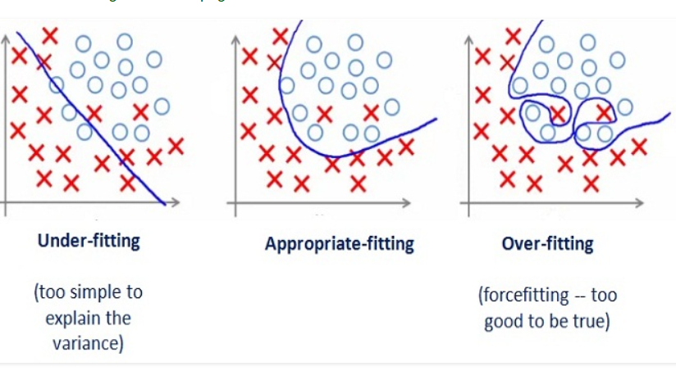
Generalization
Underfitting: model is too “simple” to represent all the relevant class characteristics
Overfitting: model is too “complex” and fits irrelevant characteristics (noise) in the data

Slide 45
Generalization
Underfitting: model is too “simple” to represent all the relevant class characteristics
Overfitting: model is too “complex” and fits irrelevant characteristics (noise) in the data

Slide 46
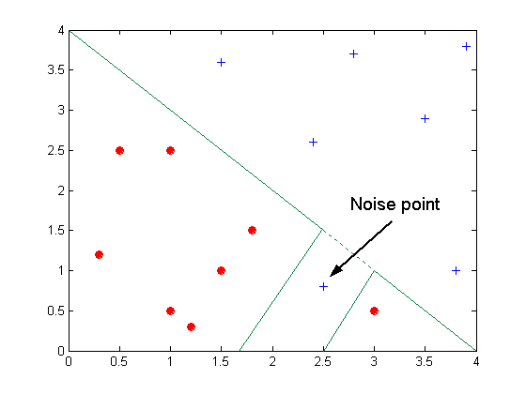
Sources of overfitting: noise
Decision boundary distorted by noise point

Slide 47
Metrics for classifier performance
Accuracy
a = number of test samples with label correctly predicted
b = number of test samples with label incorrectly predicted
example
75 samples in test set
correct class label predicted for 62 samples
wrong class label predicted for 13 samples
accuracy = 62 / 75 = 0.827
Notes:
Metrics for classifier performance can be used on any labeled partition of the data: training, validation, or test.

Slide 48
Metrics for classifier performance
 |  | actual class
 |  | class 1 | class 2
predicted class | class 1 | 21 | 6
 | class 2 | 7 | 41
Confusion matrix
Example (continued from two slides back)

Slide 49
Metrics for classifier performance
 |  | actual class
 |  | class 1 (Positive) | class 2 (Negative)
predicted class | class 1 (Positive) | 21 (TP) | 6 (FP)
 | class 2 (Negative) | 7 (FN) | 41 (TN)
Confusion matrix
derived metrics (for two classes)
TN: true negatives FN: false negatives
FP: false positives TP: true positives

Slide 50

How to evaluate your model
The metrics that you choose to evaluate your machine learning model is very important.
Accuracy: the number of correct predictions made by the model over all kinds predictions made
Accuracy should NEVER be used as a measure when the target variable classes in the data are a majority of one class.
Ex: In our cancer detection example with 100 people, only 5 people has cancer. Let’s say our model is very bad and predicts every case as No Cancer. In doing so, it has classified those 95 non-cancer patients correctly and 5 cancerous patients as Non-cancerous. Now even though the model is terrible at predicting cancer, The accuracy of such a bad model is also 95%.

Slide 51
Metrics for classifier performance
Limitations of accuracy
Consider a two-class problem
number of class 1 test samples = 9990
number of class 2 test samples = 10
What if model predicts everything to be class 1?
accuracy is extremely high: 9990 / 10000 = 99.9 %
but model will never correctly predict any sample in class 2
in this case accuracy is misleading and does not give a good picture of model quality

Slide 52
How to evaluate your model
Example: A school is running a machine learning primary diabetes scan on all of its students. The output is either diabetic (+ve) or healthy (-ve).
Accuracy answers the following question: How many students did we correctly label out of all the students?
Precision answers the following: How many of those who we labeled as diabetic are actually diabetic?
Recall answers the following question: Of all the people who are diabetic, how many of those we correctly predict?

Slide 53
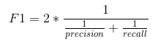
How to evaluate your model
Precision: It is the number of correct positive results divided by the number of positive results predicted by the classifier
= TP / (TP+FP)
Recall : the number of correct positive results divided by the number of all relevant samples (all samples that should have been identified as positive).
= TP / (TP+FN)
F1 score : F1 Score is the Harmonic Mean between precision and recall. The range for F1 Score is [0, 1]

Slide 54
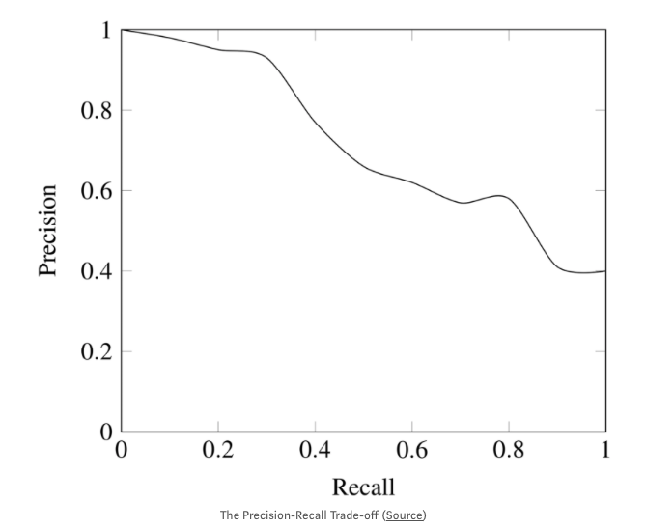
Trade-off
While recall expresses the ability to find all relevant instances in a dataset, precision expresses the proportion of the data points our model says was relevant actually were relevant.

Slide 55
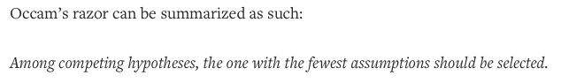
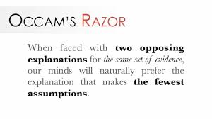
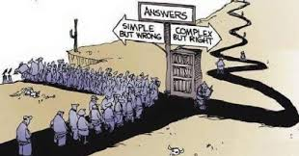
Occam’s Razor
Given two models with similar generalization errors, one should prefer the simpler model over the more complex model.
For complex models, there is a greater chance it was fitted accidentally by errors in data.
Model complexity should therefore be considered when evaluating a model.

Slide 56
Model validation
Every (useful) model offers choices in one or more of:
model structure
e.g. number of nodes and connections
types and numbers of parameters
e.g. coefficients, weights, etc
Furthermore, the values of most of these parameters will be modified (optimized) during the model training process.
Suppose the test data somehow influences the choice of model structure, or the optimization of parameters …

Slide 57

Model validation
The one commandment of machine learning
TRAIN
on
TEST

Slide 58
Regression

Slide 59
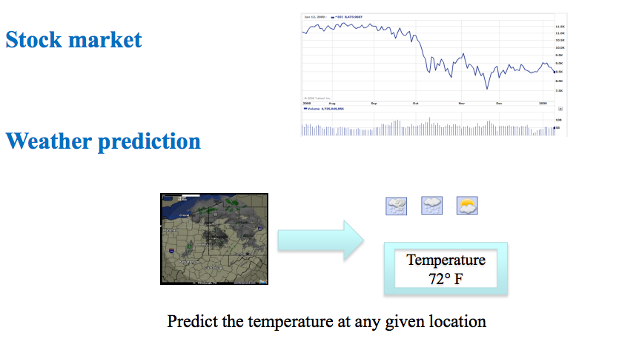
Supervised Learning
Classification = learning f with discrete output value
Regression = learning f with real-valued output value

Slide 60
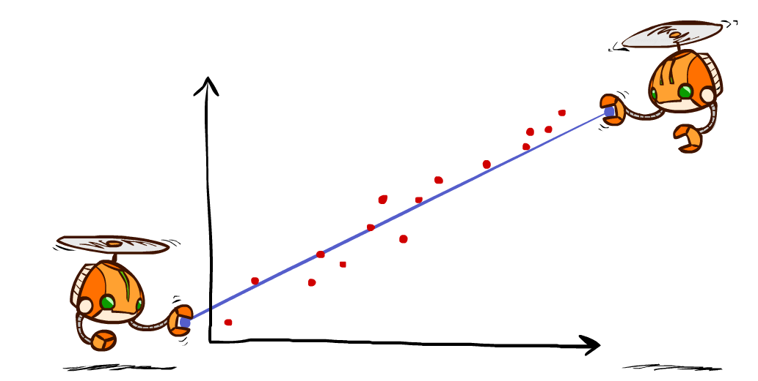
Linear Regression
Hypothesis family: Linear functions

Slide 61
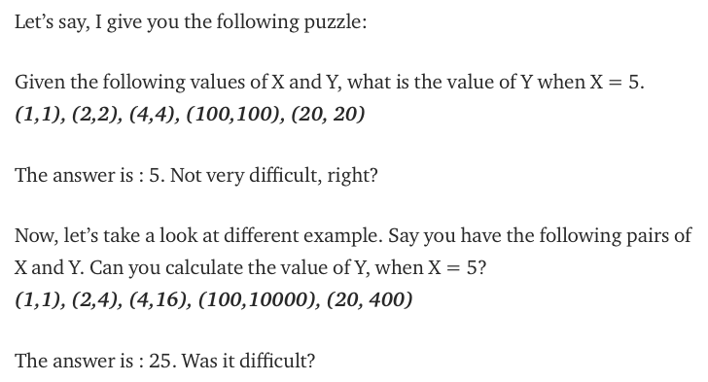
Before we start!
The relationship between X and Y is Y = X
The relationship is Y = X*X

Slide 62
Overall, machine learning works in the same way!
Your computer looks at some examples and then tries to identify “the most suitable” relationship between the sets X and Y.
Using this identified relationship, it will try to predict (or more) for new examples for which you don’t know Y.

Slide 63
Linear Regression
(x, y=f(x)), x: house size, y: house price
Berkeley house prices, 2009

Slide 64
What is Regression?
Regression is usually termed as determining relationship(s) between two or more variables.
For example, in the above example, X and Y are the variables.
X is termed as the independent variable and Y is termed as the dependent variable and Y has a continuous range (unlike classification where Y is discrete).
If we had multiple input attributes (e.g. x1, x2, x3, etc.) This would be called multiple linear regression.

Slide 65
Types of Regression Models
1 Explanatory Variable
Regression
2+ Explanatory Variables
Models
Simple
Multiple
Non-
Non-
Linear
Linear
Linear
Linear
Notes:
24
This teleology is based on the number of explanatory variables & nature of relationship between X & Y.

Slide 66
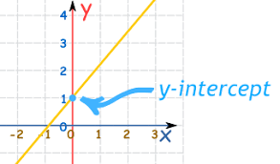
Simple Linear Regression
Simple Linear Regression (SLR) is termed as simple because there is only independent variable.
For example, consider you only have date and stock prices of a company, you can fit a regression model to the date (as X) and stock price (as Y).
The model which look something like this: Price = m*Date + c
The equation resembles that of a line with ‘m’ slope and ‘c’ y-intercept.
The equation of any straight line, called a linear equation, can be written as: y = mx + b, where m is the slope of the line and b is the y-intercept. The y-intercept of this line is the value of y at the point where the line crosses the y axis.
The most suitable values of ‘m’ and ‘c’ are the ones that produce the least error across all given X and Y.

Slide 67
Linear regression = fitting a straight line/hyperplane
40
h_{w}(x)
20
0
0
x
20
Prediction: h_{w}(x) = w₀ + w₁x
Berkeley house prices, 2009
Notes:
Figure 1: scatter(1:20,10+(1:20)+2*randn(1,20),'k','filled'); a=axis; a(3)=0; axis(a);

Slide 68
Prediction error
Error on one instance: y – h_{w}(x)
Error or “residual”
Observation y
Prediction h_{w}(x)
0
x
0
20
Notes:
Figure 1: scatter(1:20,10+(1:20)+2*randn(1,20),'k','filled'); a=axis; a(3)=0; axis(a);

Slide 69
Find w
Define loss function
Find w* to minimize loss function

Slide 70
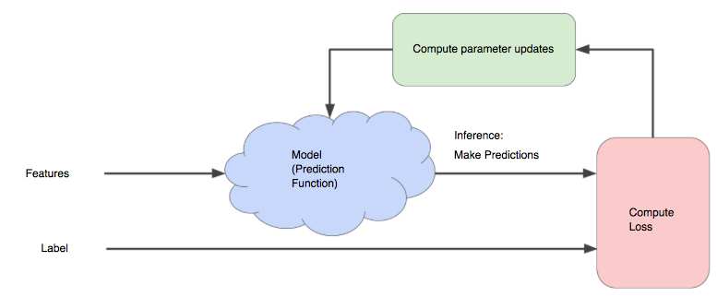
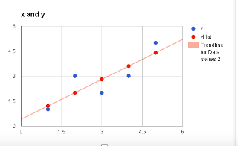
Just to check if you understand that
Once we find the best W₁ and W₀ values, we get the best fit line. So, when we are finally using our model for prediction, it will predict the value of y for the input value of x.
How to update W₁ and W₀ values to get the best fit line ?

Slide 71
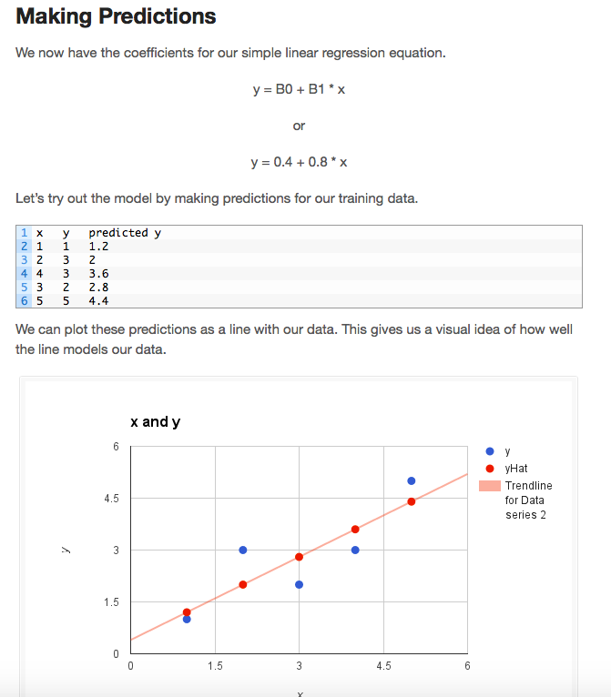

Slide 72
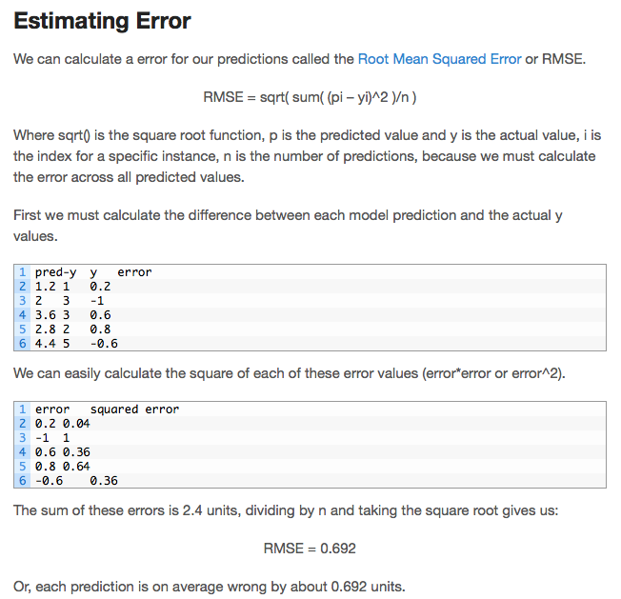
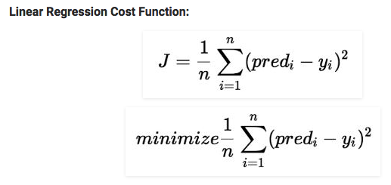
Cost Function (J):
Cost function(J) of Linear Regression can be the Root Mean Squared Error (RMSE) between predicted y value (pred) and true y value (y)
or

Slide 73
How to choose W₀ and W₁
To minimize the cost function, the model needs to have the best value of W₀ and W₁ .
Initially model selects W₀ and W₁ values randomly and then iteratively update these value in order to minimize the cost function until it reaches the minimum.
By the time model achieves the minimum cost function, it will have the best W₀ and W₁ values.
Using these finally updated values of W₀ and W₁ in the hypothesis equation of linear equation, model predicts the value of x in the best manner it can.

Slide 74
Multivariate regression
What if we have several inputs?
- Stock prices for Yahoo, Microsoft and Ebay for the Google prediction task
This becomes a multivariate regression problem
Again, its easy to model:
y = W₀ + W₁x₁+ … + W_{k}x_{k} + ε
Multiple Linear Regression

Slide 75
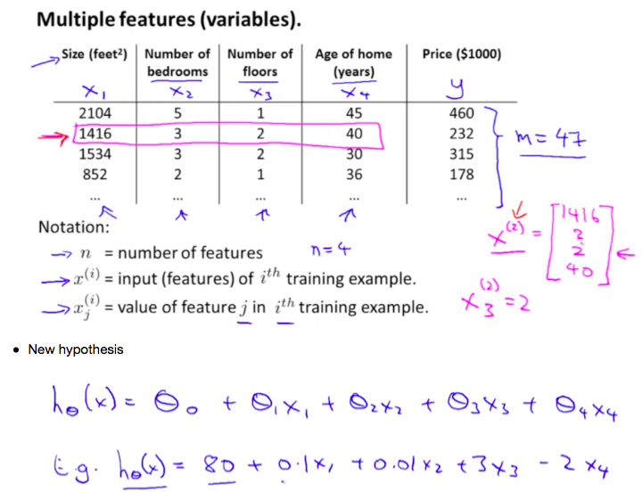

Slide 76
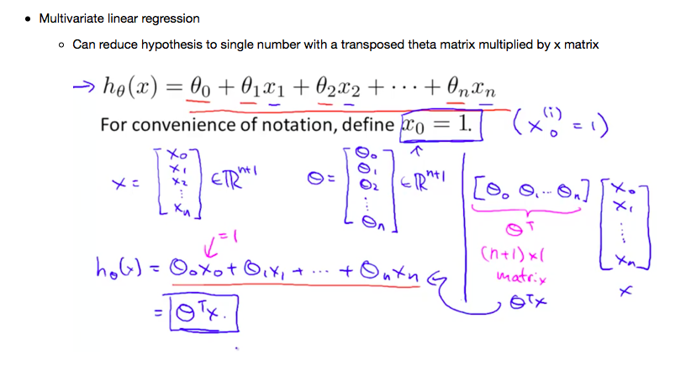

Slide 77
Gradient Descent
The goal is to minimize the cost function.
Minimizing any function means finding the deepest valley in that function.
means getting to the lowest error value possible or increasing the accuracy of the model.
We increase the accuracy by iterating over a training data set while tweaking the parameters (the weights and biases) of our model.
Do you remember the Calculus course?!?!
Using calculus, we know that the slope of a function is the derivative of the function with respect to a value. This slope always points to the nearest valley!
Gradient Descent is a very generic optimization algorithm capable of finding optimal solutions to a wide range of problems.

Slide 78

Once the gradient is zero, you have reached a minimum!

Slide 79
Learning rate
Now that we have found the direction we need to find how much to nudge the weight. Here, we use the Learning Rate.
The Learning Rate is called a hyper-parameter.
A hyper-parameter is a value required by your model which we really have very little idea about.
These values can be learned mostly by trial and error. There is no, one-fits-all for hyper-parameters.
This Learning Rate can be thought of as a, “step in the right direction,” where the direction comes from dJ/dw.
If the learning rate is too small, then the algorithm will have to go through many iterations to converge, which will take a long time

Slide 80



Problems with Gradient Descent

Slide 81


Implementing GD
To implement Gradient Descent, you need to compute the gradient of the cost function with regards to each model parameter θj.
In other words, you need to calculate how much the cost function will change if you change θj just a little bit.
This is called a partial derivative.
compute the partial derivative of the cost function with regards to parameter θj
Gradient Descent step:

Slide 82


Example!

Slide 83

Step 1: Initialize the weights(a & b) with random values and calculate Error
Step 2: Calculate the gradient i.e. change in error when the weights (a & b) are changed by a very small value from their original randomly initialized value. This helps us move the values of a & b in the direction in which error is minimized.
Step 3: Adjust the weights with the gradients to reach the optimal values where error is minimized
Step 4: Use the new weights for prediction and to calculate the new error
Step 5: Repeat steps 2 and 3 till further adjustments to weights doesn’t significantly reduce the Error
our objective is to find optimal a, b that minimizes the error between actual and predicted values

Slide 84


Standardize the data

Slide 85


Slide 86

Step 3:

Slide 87



Polynomial Regression
Linear regression requires the relation between the dependent variable and the independent variable to be linear. What if the distribution of the data was more complex as shown in the below figure? Can linear models be used to fit non-linear data? How can we generate a curve that best captures the data as shown below?

Slide 88


To overcome under-fitting, we need to increase the complexity of the model.

Slide 89

A simple way to do this is to add powers of each feature as new features, then train a linear model on this extended set of features. This technique is called Polynomial Regression.
This is still considered to be linear model as the coefficients/weights associated with the features are still linear. x² is only a feature. However, the curve that we are fitting is quadratic in nature.
To convert the original features into their higher order terms we will use the PolynomialFeatures class provided by scikit-learn. Next, we train the model using Linear Regression.
The linear model,
can be transformed to

Slide 90

Learning Curves
If you perform high-degree Polynomial Regression, you will likely fit the training data much better than with plain Linear Regression. But?!?!?

